Slide 1
OOR E-File Appeal Portal
User Training
Notes:
Welcome to the OOR’s E-File Portal User Training.
This slide presentation will cover all aspects of the E-File Portal that a user will encounter during the course of an appeal.

Slide 2
Glossary
RTKL ― the Pennsylvania Right-to-Know Law
OOR ― Pennsylvania Office of Open Records
REQUESTER ― a legal US resident that files a request for records with an agency under the RTKL
AGENCY ― a Commonwealth agency (i.e. state government agency), a local agency (i.e. a county, a township, a borough, a school district), a judicial agency (i.e. a court of the Commonwealth or office of the state unified judicial system), or a legislative agency (i.e. the Pennsylvania Senate or House of Representatives)
APPEAL ― the process a requester uses to challenge an agency’s response to a RTKL request when a requester is not satisfied with the response or did not receive a response
AGENCY OPEN RECORDS OFFICER ― a person designated by the agency to handle RTKL requests, also known as an “AORO”
PARTY ― the participants in a RTKL appeal with the OOR such as, the requester and the agency
E-FILE PORTAL ― an online docketing records management system designed to streamline and automate the RTKL appeals process before the OOR
Notes:
The User Guide includes a glossary of common terms used during the RTKL request process and appeal process

Slide 3
Glossary
LOGIN CREDENTIALS ― a party’s email address and password given by the OOR at the start of an appeal to give that party permission to sign in and use the online E-File Appeal Portal
ENTRY OF APPEARANCE ― form completed by a person who will represent a party in an appeal. The representative can be an attorney or other representative who will submit documents to or communicate with the OOR during an appeal, also known as an “EoA”
APPEALS OFFICER ― employee of the OOR who receives evidence in a RTKL appeal and issues a final decision, or Final Determination
EVIDENCE ― documents or correspondence submitted in a RTKL appeal to support a party’s argument, such as position statements, legal arguments or exhibits
DIRECT INTEREST PARTICIPANT ― a person or an entity like a company that is not the requester or the agency, but has an interest in the records that were requested from an agency, also known as a “DIP”
DOCKET SHEET ― a chronological list of all documents and communications that are submitted to the online portal account for an appeal, including the Final Determination

Slide 4
Preliminary Points
Only the Parties to an individual appeal are able to view the docket and uploaded materials.
The Final Determination and post Final Determination documents will be public.
The E-File Portal refreshes once an hour.
You will not immediately receive an email notification confirming your submission or upload.

Slide 5
Log In and
Reset Password

Slide 6
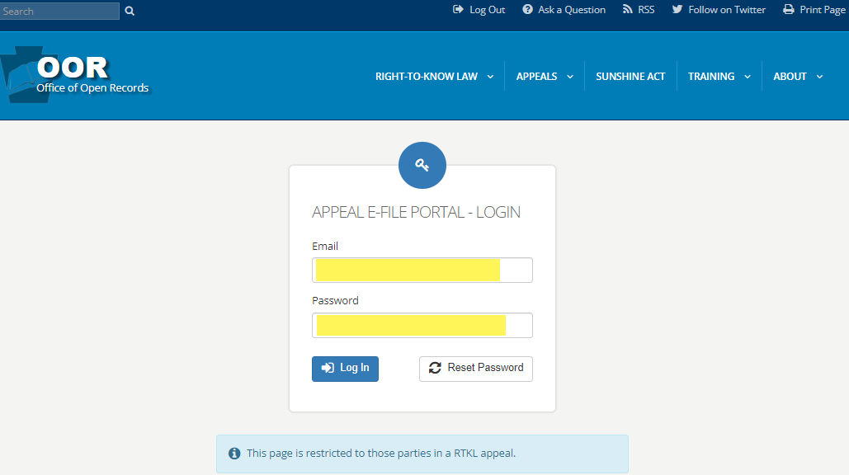
Logging in to E-File Portal
Notes:
When you are served with a Notice of Appeal in a matter assigned to E-File Portal, you will receive login credentials to enable you to access the appeal docket through the E-File Portal. The credentials will consist of your email address and a password.
Your login credentials will remain the same for all subsequent RTKL appeals that you are involved with.

Slide 7
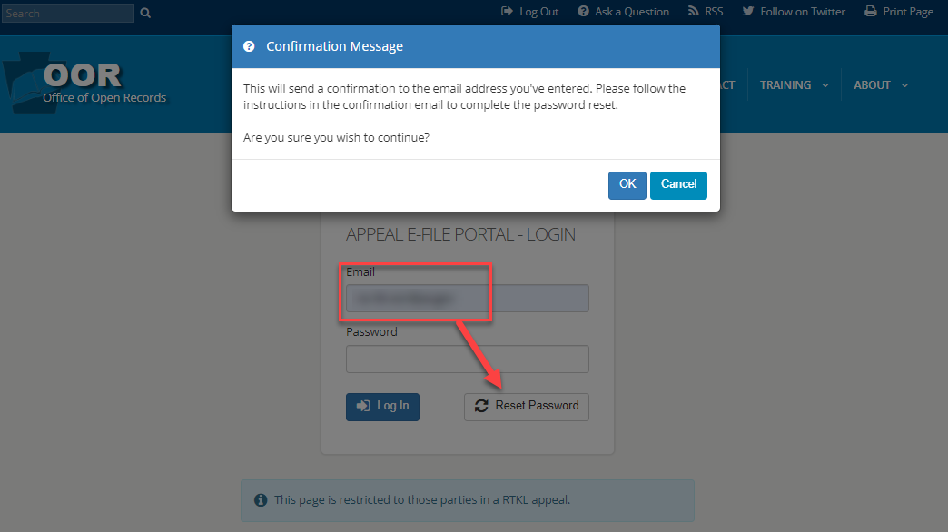
Resetting a Password
Notes:
Once you have been granted login credentials you have the option to change your password.
If you don’t remember your password later in the appeal process, you can also reset it.

Slide 8
Using the
E-File Portal

Slide 9
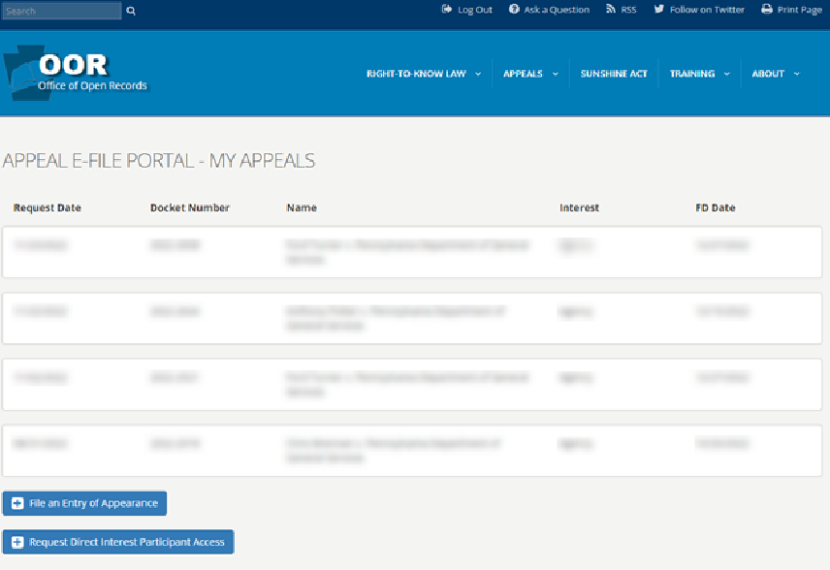
List of OOR Dockets
Notes:
All of your appeals will be listed and will be accessible when you login to the E-File Portal. This will be the case whether you have 1 appeal or multiple appeals.
On this page there is also a link to file an Entry of Appearance or EoA for a specific appeal.

Slide 10
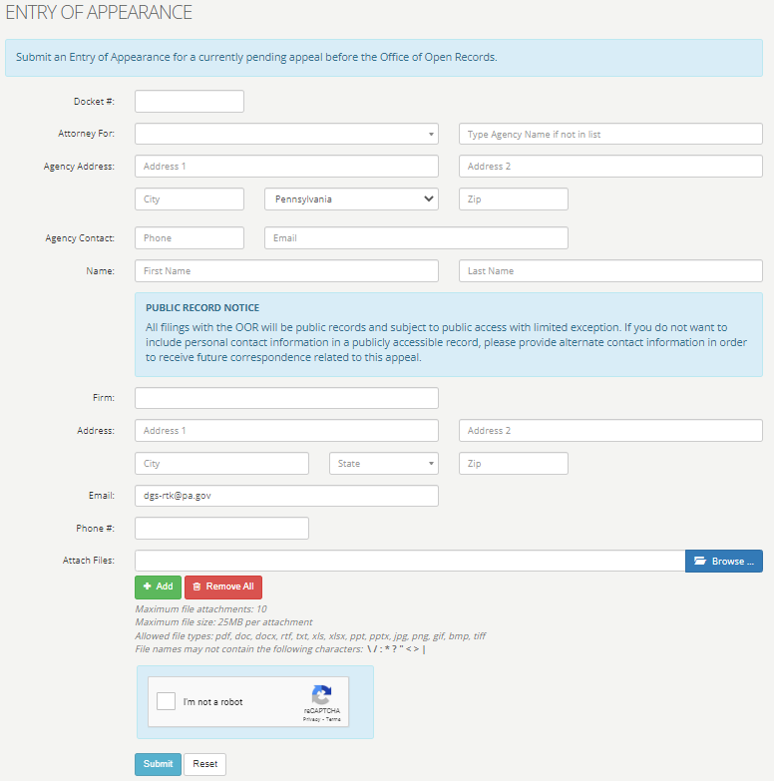
File an Entry of Appearance
Notes:
When an appeal is docketed with the OOR and a Notice of Appeal is issued, the Requester and the Agency Open Records Officer or AORO will receive login credentials and will be granted docket access.
If either party will be represented on appeal, i.e. a Requester has Counsel or an Agency has a Solicitor, the Entry of Appearance or “EoA” form must be completed.
An electronic EoA form is also available on the OOR website under the “Appeals” menu.
The electronic EoA form is the preferable method, but a “paper” EoA that is uploaded to the docket by a party who already has E-File Portal access will also be accepted.

Slide 11
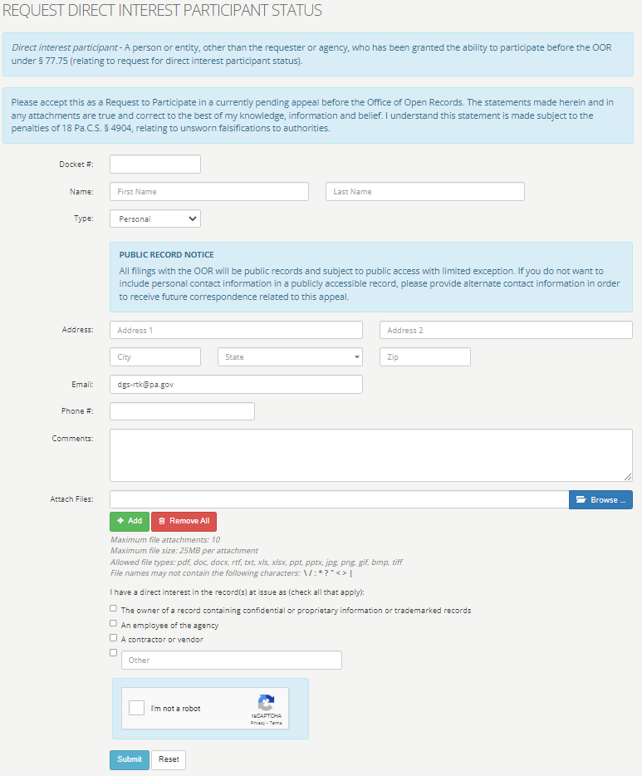
Request Direct Interest Participant Status
Notes:
NOTE: a Direct Interest Participant Status form is NOT for the Parties, such as the Requester, the Agency or counsel for either party.
Direct Interest Participant or DIP Status Request is only for outside parties or their counsel that may have an interest in the records at issue on appeal.
The DIP Status Request form is also available on the “Appeals” drop-down menu on the OOR website.
The electronic DIP form is the preferable method, but a “paper” DIP that is uploaded to the docket by a party who already has E-File Portal access will also be accepted.
When a DIP Request is submitted, the Appeals Officer will review it to determine if a third-party interest in the appeal has been demonstrated.
The Appeals Officer will contact the parties with a DIP determination and an explanation of the next steps in the process.
A DIP has access to the online portal account and all submission documents and communications that have been added to the docket sheet through the Portal.

Slide 12
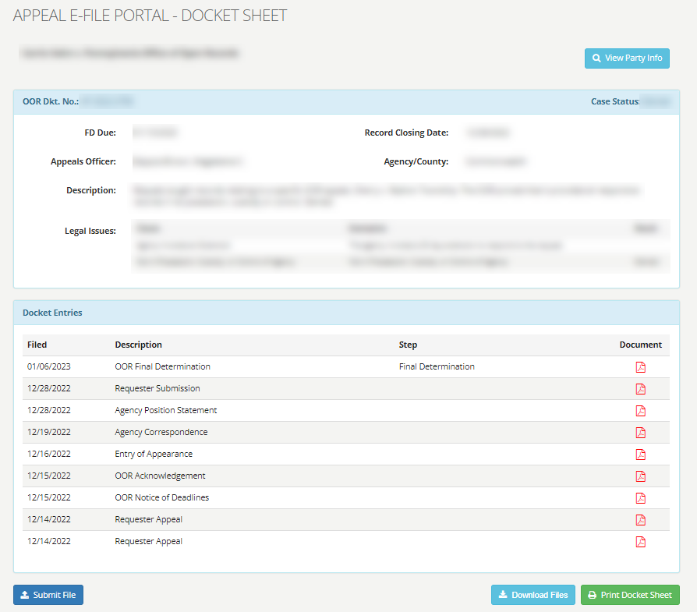
Docket Sheet
Notes:
This slide is an example of what you will see when viewing the docket sheet.

Slide 13
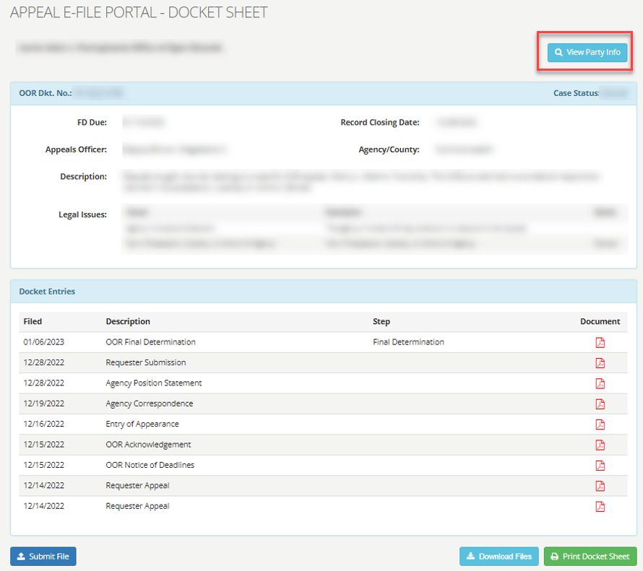
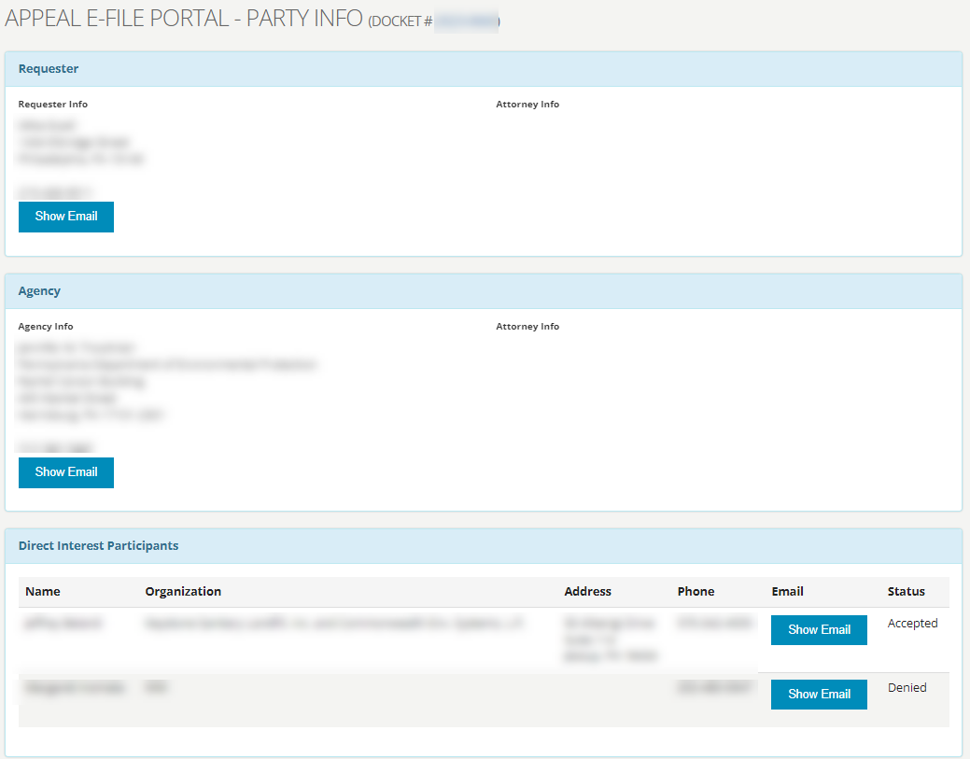
View Party Info on Docket Sheet
Notes:
On this page a party is able to see all party participant information. Simply click the “View Party Info” button.

Slide 14
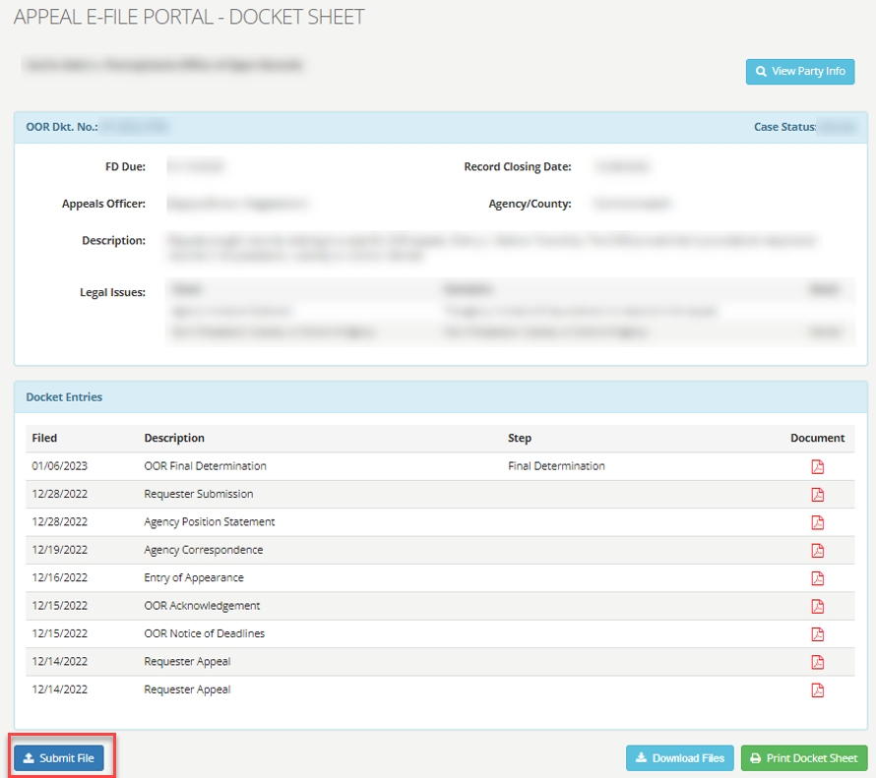
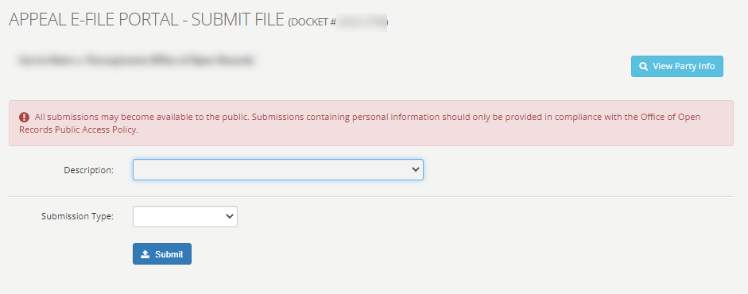
Submit File from Docket Sheet
Notes:
These 4 slides go through the steps for a user to upload documents to the Portal.
This slide depicts the view when a user presses the “Submit File” button on the docket view page.

Slide 15
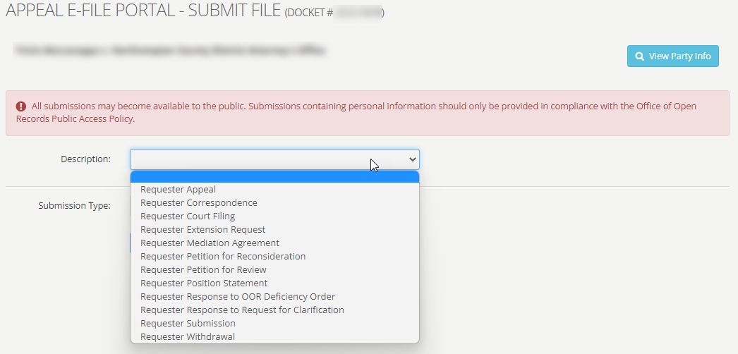
Submit File – Requester Description Choices
Notes:
This slide depicts the Requester’s view of the document upload page.
The drop-down menu provides the user with document descriptions for uploading purposes, i.e. Requester Correspondence or Requester Submission.
Choose the description that best describes your document. If it is an incorrect description, the Appeals Officer can change the description to the correct name.

Slide 16
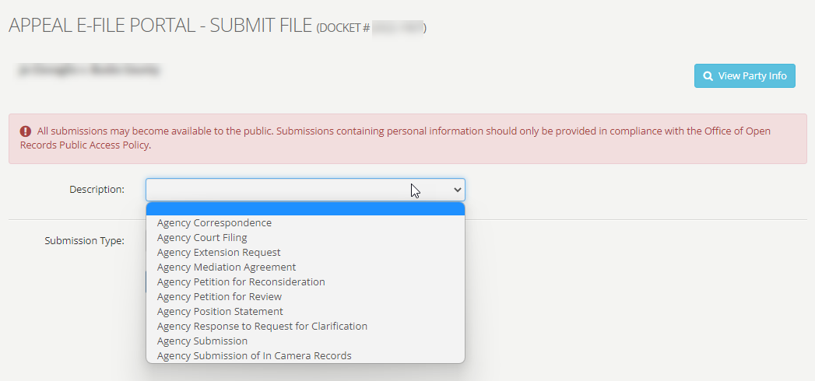
Submit File – Agency Description Choices
Notes:
This slide depicts the Agency’s view of the document upload page.
The drop-down menu provides the user with document descriptions for uploading purposes, i.e. Agency Correspondence or Agency Submission.

Slide 17
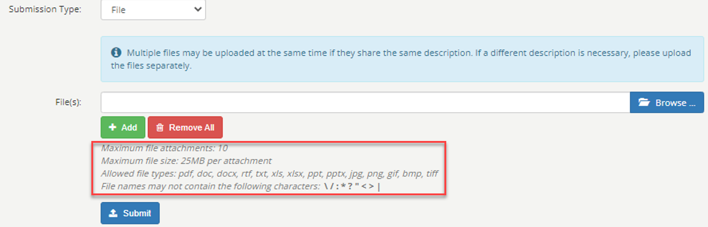
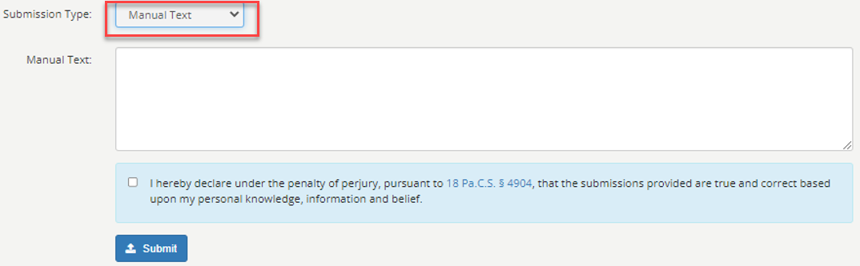
Submitting Files
Notes:
Please take note of the file limitations and formats that can be accepted through the E-File Portal.
The limitations are highlighted on the slide in the box above “Submit”.
If you have problems or questions, contact the OOR staff at openrecords@pa.gov or 717-346-9903.
In addition, short and more informal correspondence may be sent through the E-File Portal by way of a “Manual Text” box. Using “Manual Text” is similar to sending an email or a text message.

Slide 18
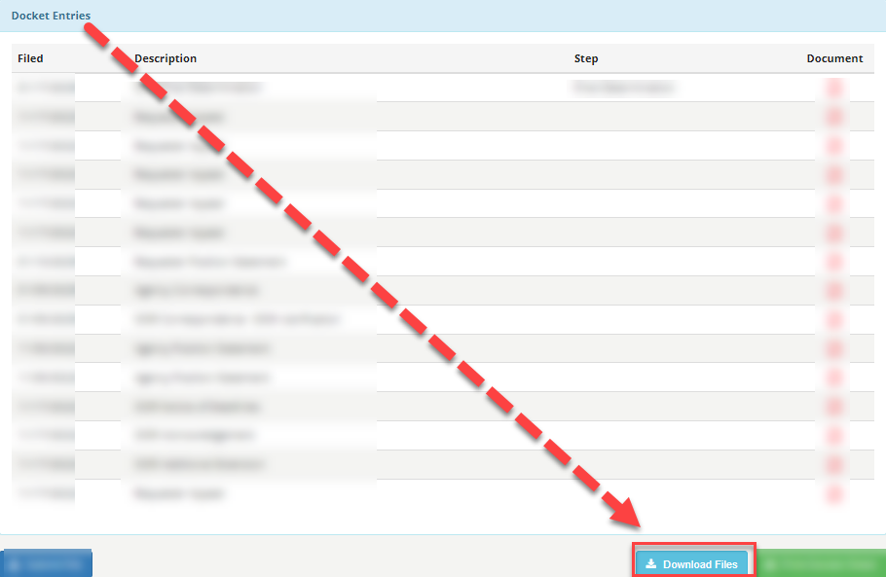
Docket Sheet – Download Files
Notes:
A party is able to download, save, and/or print the docket sheet for an individual appeal.
The save function allows a user to save a file to a personal device such as, a laptop.

Slide 19
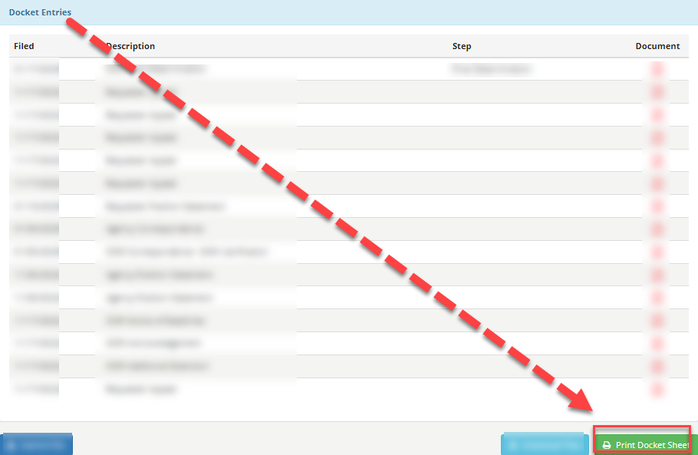
Docket Sheet – Print Docket Sheet
Notes:
The print function allows a user to print the entire docket sheet for an appeal.

Slide 20
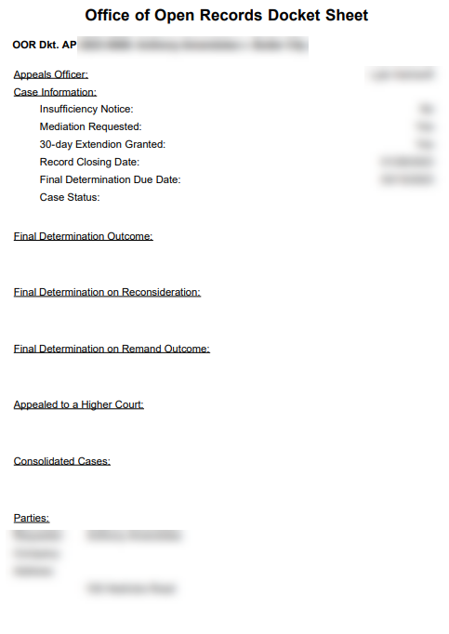
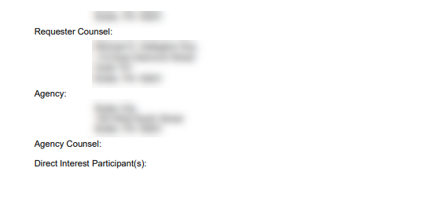
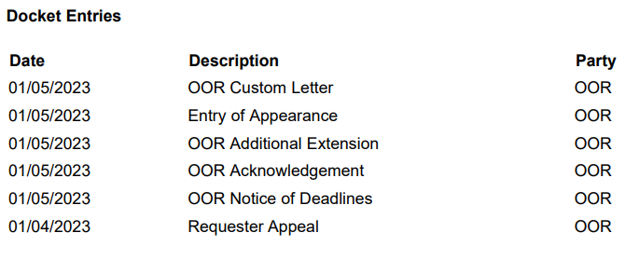
Docket Sheet – Printed Docket Sheet
Notes:
This slide shows an example of the printed docket sheet.
This view shows the appeal case information, party information, as well as dates and descriptions of individual docket entries.

Slide 21
Examples of Emails Sent
Notes:
Parties will receive email alerts when any party uploads documents or communications to the online E-File Portal account for a particular appeal.
The following slides depict examples of email alerts a user will receive.

Slide 22
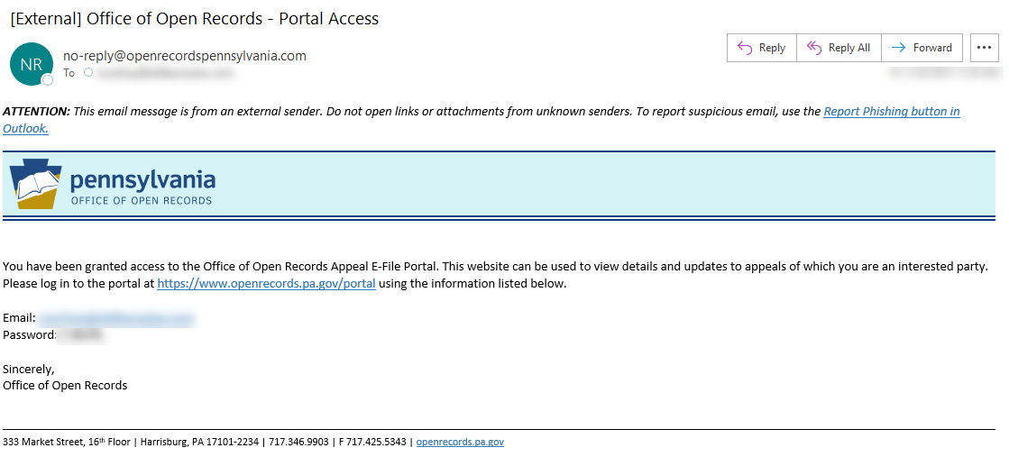
Portal Access Email
Notes:
This slide depicts the email a party will receive when portal access has been granted. It will include login credentials.

Slide 23
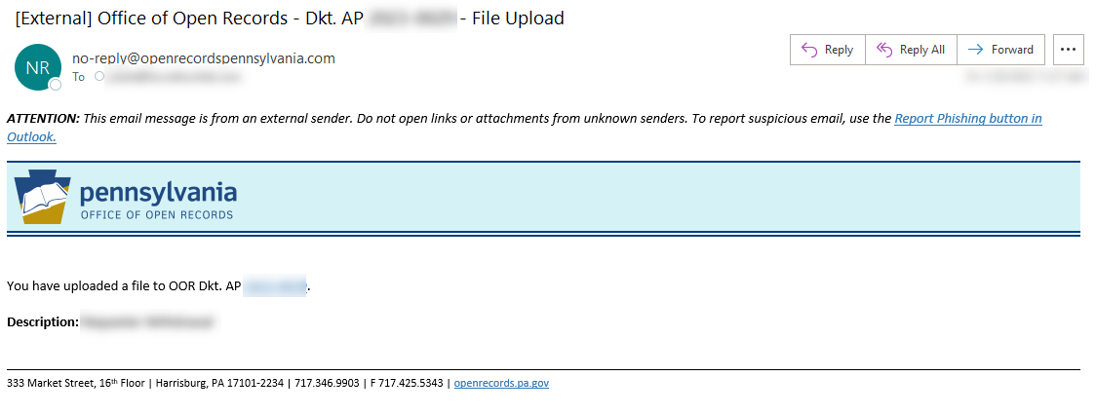
File Uploaded
Notes:
This slide depicts the email alert a party will receive after a user uploads a document to the E-File Portal. This is your upload confirmation.
The email will specify the description type of document uploaded, i.e. correspondence, submission, position statement, Entry of Appearance, etc.

Slide 24
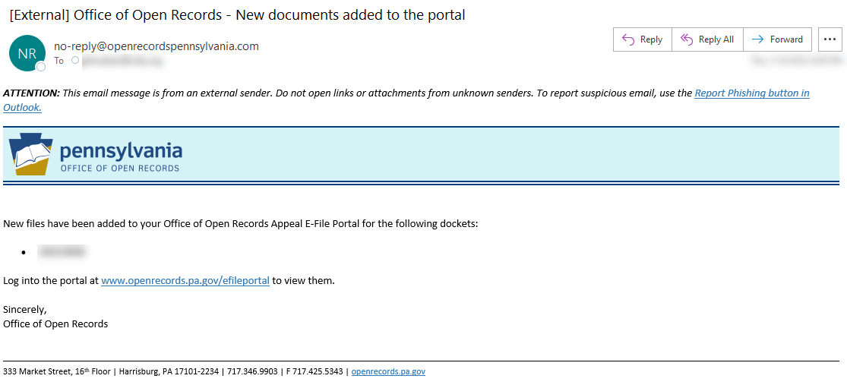
New Documents Added
Notes:
This slide depicts the email alert all parties will receive after a document has been uploaded to the E-File Portal and accepted by the Appeals Officer.
Email Alerts for urgent communications will have a red exclamation point.

Slide 25
E-File Portal Links
E-File Portal Login
  https://www.openrecords.pa.gov/portal
User Guide
  https://www.openrecords.pa.gov/Documents/Appeals/E-File_AppealPortal-UserGuide.pdf
Notes:
REMINDERS:
Only the parties to an appeal are able to view the docket sheet.
The E-File Portal refreshes once per hour.

Slide 26
OOR Contact Information
Comments and feedback are welcome.
Email: openrecords@pa.gov
Phone: (717) 346-9903
Website: https://www.openrecords.pa.gov
Blog: https://openrecordspennsylvania.com/
Twitter: https://twitter.com/OpenRecordsPA
Notes:
REMINDERS:
Only the parties to an appeal are able to view the docket sheet.
The E-File Portal refreshes once per hour.

